Slide 1


Lecture 3 pointer
Dynamic memory
DATA STRUCTURE
AND ALGORITHMS
(CS 201)
3
Fall (2025-2026)

Slide 2
Course Learning Objectives
Implement and manipulate linear data structures such as arrays and linked lists, performing fundamental operations including insertion, deletion, and traversal.
Apply and implement special linear data structures such as stacks and queues, utilizing their core operations (push, pop, enqueue, and dequeue).
Design and implement basic sorting algorithms to organize data efficiently.
Apply searching algorithms, including sequential search, binary search, and hashing techniques.
Implement and manipulate non-linear data structures, particularly binary trees and binary search trees, performing key operations such as insertion, deletion, and traversal.
Utilize graph data structures and apply fundamental graph algorithms for problem-solving.
Demonstrate effective teamwork skills by collaborating within groups to develop algorithmic solutions.

Slide 3
Abstract Data Types

Slide 4
Abstract Data Types (ADT)
A data type created by programmers that specifies
values that can be stored
operations that can be done on the values
User of an ADT does not need to know the implementation of the data type

Slide 5
Enumerated Data Type
A programmer-defined data type that consists of values known as enumerators,
which represent integer constants.
enum Day { SUNDAY, MONDAY, TUESDAY, WEDNESDAY, THURSDAY };
int main()
{
Day day1, day2; // Declare
day1 = MONDAY; // Assign to one of the values cout << day1; // Prints 1
What the compiler sees:
SUNDAY = 0
MONDAY = 1
TUESDAY = 2
WEDNESDAY = 3
THURSDAY = 4
1
cin >> day2;
Day day3 = WEDNESDAY; // Declare and Assign if (day3 > MONDAY) { … }
}

Slide 6
Computer Memory
Each variable is assigned a memory slot (the size depends on the data type) and the variable’s data is stored there
Memory address:
1020
1024
1032
…
…
100
…
1024
…
a
Variable a’s value, i.e., 100, is
stored at memory location 1024
int a = 100;

Slide 7
Pointers
A pointer is a variable used to store the address of a memory cell.
We can use the pointer to reference this memory cell
integer
pointer
Memory address:
1020
1024
1032
…
…
100
…
1024
…
a
Variable a’s value, i.e., 100, is
stored at memory location 1024
int a = 100;

Slide 8
Using pointers
int count = 5;
short status = 2;
char letter = 'A';
string s("ABC");
int* pCount;
short* pStatus;
char* pLetter;
string* pString;
pCount = &count;
pStatus = &status;
pLetter = &letter;
pString = &s;
count | 5
status | 2
letter | 'A'
s | "ABC"
Declare before use
pCount
pStatus
pLetter
pString
pCount | Address of count
pStatus | Address of status
pLetter | Address of letter
pString | Address of s
Address operator
// &status means address of status

Slide 9
Using pointers
The value of count is 5
The address of count is 010FFE98
The address of count is 010FFE98
The value of count is 5
int count = 5;
int* pCount = &count;
cout << "The value of count is " << count << endl;
cout << "The address of count is " << &count << endl;
cout << "The address of count is " << pCount << endl;
cout << "The value of count is " << *pCount << endl;
count++; // Direct reference to count
(*pCount)++; // Indirect reference to count (Dereferencing)
*pCount means the value pointed to by pCount

Slide 10
Don’t get confused
Two different tasks are represented with the same sign (*)
Declaring a pointer: int *p = &a;
    Dereferencing a pointer: cout << (*p); // the value pointed to by p

Slide 11
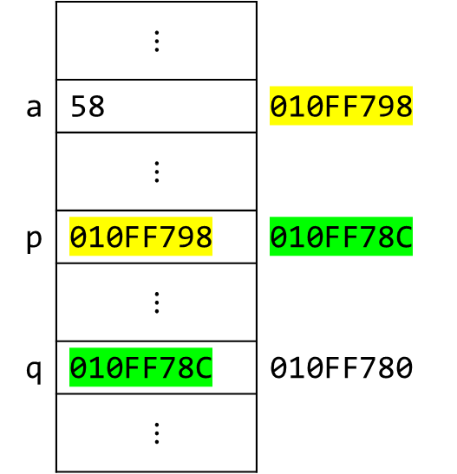
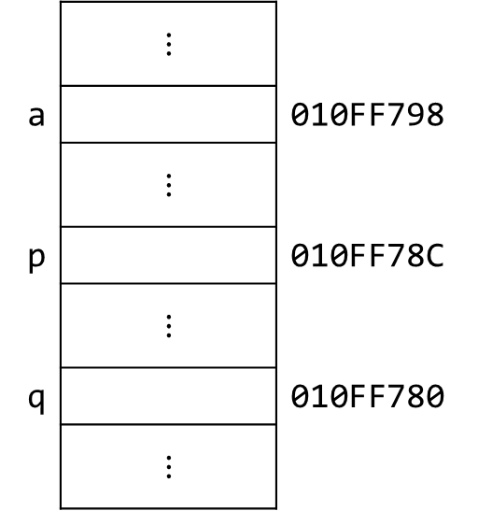
Pointer to Pointer
 | $$⋮$$
a | 58 | 010FF798
 | $$⋮$$
p | 010FF798 | 010FF78C
 | $$⋮$$
q | 010FF78C | 010FF780
 | $$⋮$$
 | $$⋮$$
a |  | 010FF798
 | $$⋮$$
p |  | 010FF78C
 | $$⋮$$
q |  | 010FF780
 | $$⋮$$
int a;//Integer
int* p;//Pointer
int** q;//Pointer to Pointer
a = 58;
p = &a;
q = &p;
cout << a << endl;
cout << p << endl;
cout << *p << endl;
cout << q << endl;
cout << *q << endl;
cout << **q << endl;
cout << &q << endl;
58
010FF798
58
010FF78C
010FF798
58
010FF780

Slide 12
Using pointers
It is a syntax error if the type of the variable does not match the type of the pointer.
  int area = 1;
  double* pArea = &area;
  To prevent errors, you should always initialize pointers
    double* pArea = 0;
    double* pArea = NULL; // #define NULL 0
    double* pArea = nullptr; // reserved pointer that
    does not point to any valid
    memory location
    if (!pArea) {... // This block will be executed
    if pArea is null
Notes:
Dereferencing a non initialized pointer may cause fatal runtime error or modify important data.

Slide 13
Using pointers
  Declaring a pointer
double* pArea;
double *pArea;
double * pArea;
  Declaring more than one pointer in one line
  double* pArea, area; // A pointer and a double
  double* pArea, *area; // Two pointers
!

Slide 14
What is the difference?
int x = 5;
int y = 6;
int* pX = &x;
int* pY = &y;
pX = pY;
int x = 5;
int y = 6;
int* pX = &x;
int* pY = &y;
*pX = *pY;

Slide 15
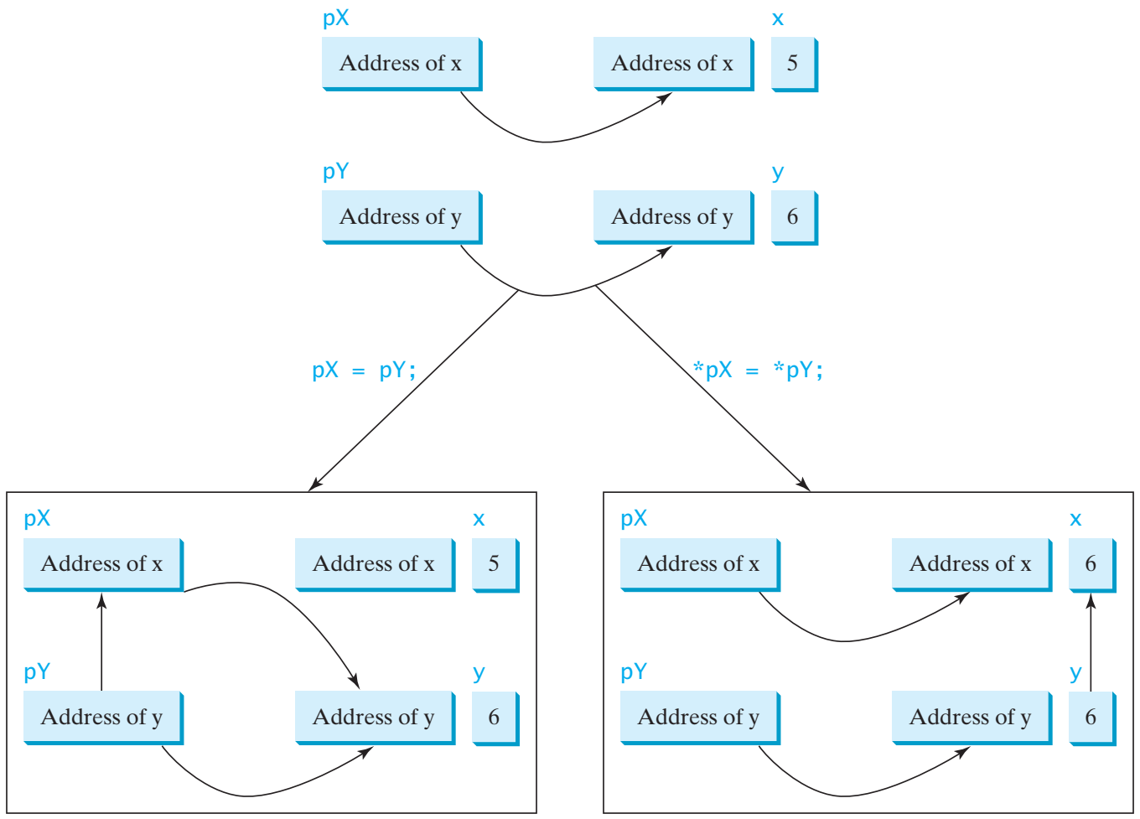
pX = pY;
*pX = *pY;

Slide 16
Example
int main()
{
int value1 = 5, value2 = 15;
int* p1, * p2;
p1 = &value1; // p1 = address of value1
p2 = &value2; // p2 = address of value2
*p1 = 10; // value pointed to by p1=10
*p2 = *p1; // value pointed to by p2= value
// pointed to by p1
p1 = p2; // p1 = p2 (pointer value copied)
*p1 = 20; // value pointed to by p1 = 20
cout << "value1==" << value1 << "/ value2==" << value2;
return 0;
}
value1==10 / value2==20

Slide 17


Which one should work? Why?
// Swap two variables using
void swap1(int n1, int n2)
{
int temp = n1;
n1 = n2;
n2 = temp;
}
// Swap two variables using
void swap3(int* p1, int* p2)
{
int temp = *p1;
*p1 = *p2;
*p2 = temp;
}
// Swap two variables using
// pass-by-value
void swap1(int n1, int n2)
{
int temp = n1;
n1 = n2;
n2 = temp;
}
// Swap two variables using
// pass by pointers
void swap3(int* p1, int* p2)
{
int temp = *p1;
*p1 = *p2;
*p2 = temp;
}
// Swap two variables using
void swap2(int& n1, int& n2)
{
int temp = n1;
n1 = n2;
n2 = temp;
}
// Swap two variables using
// pass-by-reference
void swap2(int& n1, int& n2)
{
int temp = n1;
n1 = n2;
n2 = temp;
}

Slide 18
Which one should work? Why?
// Swap two variables using
// pass-by-value
void swap1(int n1, int n2)
{
int temp = n1;
n1 = n2;
n2 = temp;
}
// Swap two variables using
// pass by pointers
void swap3(int* p1, int* p2)
{
int temp = *p1;
*p1 = *p2;
*p2 = temp;
}
int main()
{
int num1 = 1, num2 = 2;
swap1(num1, num2);
return 0;
}
int main()
{
int num1 = 1, num2 = 2;
swap3(&num1, &num2);
return 0;
}
// Swap two variables using
// pass-by-reference
void swap2(int& n1, int& n2)
{
int temp = n1;
n1 = n2;
n2 = temp;
}
int main()
{
int num1 = 1, num2 = 2;
int* p1 = &num1;
int* p2 = &num2;
swap3(p1, p2);
return 0;
}
int main()
{
int num1 = 1, num2 = 2;
swap2(num1, num2);
return 0;
}

Slide 19
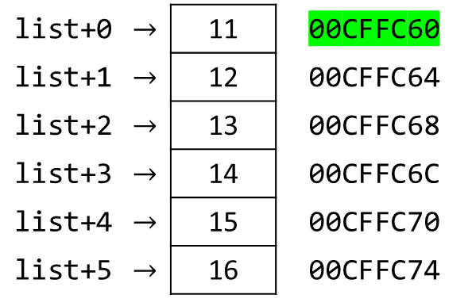
Arrays and Pointers
An array variable name is a pointer to the first element.
int list[6] = { 11, 12, 13, 14, 15, 16 };
cout << &list[0] << endl;
cout << list << endl;
cout << list[0] << endl;
cout << *list << endl;
cout << list[3] << endl;
cout << *(list+3) << endl;
list+0 | $$→$$ | 11 | 00CFFC60
list+1 | $$→$$ | 12 | 00CFFC64
list+2 | $$→$$ | 13 | 00CFFC68
list+3 | $$→$$ | 14 | 00CFFC6C
list+4 | $$→$$ | 15 | 00CFFC70
list+5 | $$→$$ | 16 | 00CFFC74
00CFFC60
00CFFC60
11
11
Is it the same as *list+3 ?
14
14

Slide 20
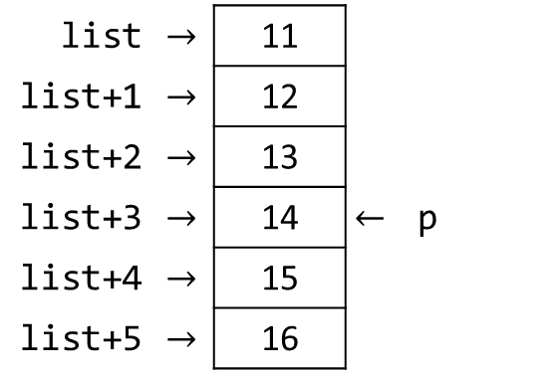
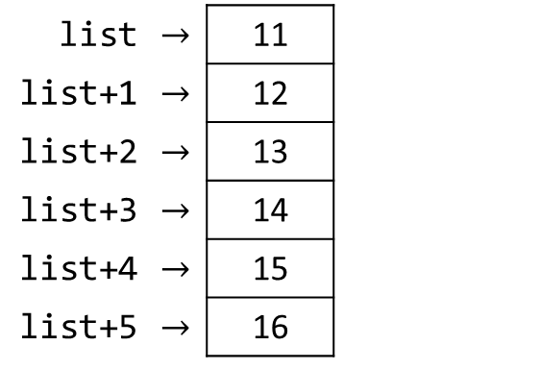
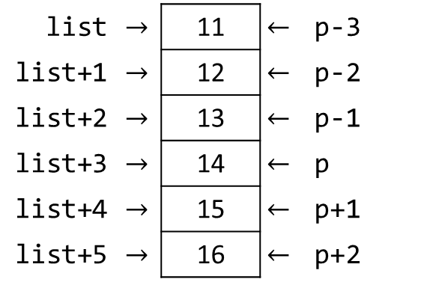
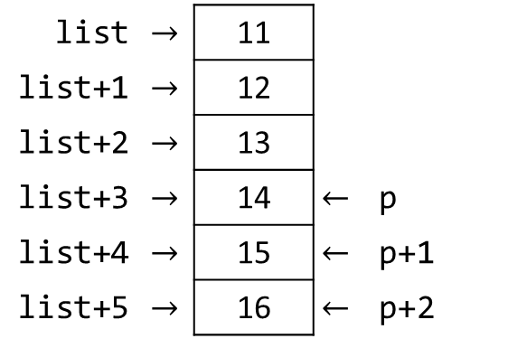
Arrays and Pointers
int list[] = { 11, 12, 13, 14, 15, 16 };
int* p = &list[3];
cout << list[0] << " " << p[-3] << endl;
cout << list[3] << " " << p[0] << endl;
cout << list[5] << " " << p[2] << endl;
cout << list[4] << " " << p[-1] << endl;
cout << list[3] << " " << p[3] << endl;
11 11
14 14
16 16
15 13
14 -858993460
list | $$→$$ | 11
list+1 | $$→$$ | 12
list+2 | $$→$$ | 13
list+3 | $$→$$ | 14
list+4 | $$→$$ | 15
list+5 | $$→$$ | 16
list | $$→$$ | 11 | $$←$$ | p-3
list+1 | $$→$$ | 12 | $$←$$ | p-2
list+2 | $$→$$ | 13 | $$←$$ | p-1
list+3 | $$→$$ | 14 | $$←$$ | p
list+4 | $$→$$ | 15 | $$←$$ | p+1
list+5 | $$→$$ | 16 | $$←$$ | p+2
list | $$→$$ | 11
list+1 | $$→$$ | 12
list+2 | $$→$$ | 13
list+3 | $$→$$ | 14 | $$←$$ | p
list+4 | $$→$$ | 15
list+5 | $$→$$ | 16
list | $$→$$ | 11
list+1 | $$→$$ | 12
list+2 | $$→$$ | 13
list+3 | $$→$$ | 14 | $$←$$ | p
list+4 | $$→$$ | 15 | $$←$$ | p+1
list+5 | $$→$$ | 16 | $$←$$ | p+2

Slide 21
Array of Pointers & Pointer to Array
A pointer to an array
An array of Pointers
int list[5] = { 9, 8, 7, 6, 5 };
int* p;
p = list;
p = &list[0];
p = &list[1];
p = list + 1;
int a = 1, b = 2, c =3;
int* p[5];
p[0] = &a;
p[1] = &b;
p[2] = &c;
a
b
p[0]
p[1]
p[2]
p[3]
p[4]
p
c
list[0]
list[1]
list[2]
list[3]
list[4]
p

Slide 22
Using arrays with functions
Self Study
void printArray(int* list, int size)
{
for (int i = 0; i < size; i++)
cout << list[i] << " ";
}
void printArray(int list[], int size)
{
for (int i = 0; i < size; i++)
cout << list[i] << " ";
}

Slide 23
Using arrays with functions
Self Study
int* reverse(int* list, int size)
{
for (int i = 0, j = size - 1; i < j; i++, j--)
{
int temp = list[j];
list[j] = list[i];
list[i] = temp;
}
return list;
}
Not a new copy
The function must not return a pointer to a local variable.
A function should only return a pointer:
  To data that was passed to the function as an argument, or
  To dynamically allocated memory

Slide 24
Using arrays with functions
Self Study
int* reverse(int* list, int size)
{
for (int i = 0, j = size - 1; i < j; i++, j--)
{
int temp = list[j];
list[j] = list[i];
list[i] = temp;
}
return list;
}
void printArray(int* list, int size)
{
for (int i = 0; i < size; i++)
cout << list[i] << " ";
}
int main()
{
int list[] = {1, 2, 3, 4, 5, 6};
printArray(list, 6);
int* p = reverse(list, 6);
printArray(p, 6);
return 0;
}
What if we used printArray(list, 6)?

Slide 25
Using const with Pointers
22

Slide 26
Using const with Pointers
You can declare a constant pointer.
double radius = 5;
double* const pValue1 = &radius;
const double* pValue2 = &radius;
const double* const pValue3 = &radius;
constant data
constant pointer
Cannot change the address stored in the pointer
Cannot change the data using this pointer
47

Slide 27
Using const with Pointers
You can declare a constant pointer.
double radius = 5;
const double* pValue = &radius;
const double radius = 5;
const double* pValue = &radius;
Optional
Must be added
48

Slide 28
Using const with Pointers
double radius = 5;
double length = 5;
double* const p1 = &radius;
*p1 = 6; // -------------------------->
p1 = &length; // --------------------->
const double* p2 = &radius;
*p2 = 6; // -------------------------->
p2 = &length; // --------------------->
const double* const p3 = &radius;
*p3 = 6; // -------------------------->
p3 = &length; // --------------------->
OK? | Wrong?
OK? | Wrong?
OK? | Wrong?
49

Slide 29
Dynamic memory
22

Slide 30
Dynamic Memory
Allows obtaining memory at runtime.
Why?
Amount of required data may be unknown at compile time
Efficient memory use:
Allocate as much as needed
Free when not needed

Slide 31

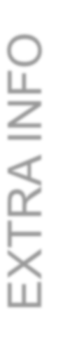




Memory Segments
EXTRA INFO
Code Segment | Fixed size |  | Program, Const (?)
Data Segment | Fixed size |  | Static, Global
Heap Bad Alloc exception | ⍖ | Growth | Dynamically allocated memory
Stack Overflow Stack | ⍏ | Growth | Temporary storage Statically allocated memory

Slide 32
Dynamic Memory Allocation / Deallocation
int x; x = 2;
Allocate in
heap
pInt
Address
10
int *pInt ; pInt = new int;
*pInt = 10;
Deallocate
from heap
delete pInt; pInt = nullptr;
pItt
Utititialized
Utititialized itt
x
2
Uninitialized
Stack
Heap
pInt
0
ooo
pItt
UtitDaAdngitiadrliesnglizs!!ed
Utititialize10 d itt
x
2
Uninitialized
Stack
Heap
Prevent "dangling pointers," which are pointers that point to deallocated memory

Slide 33
Dynamic Memory Allocation/Deallocation
int* p1 = new int; // Allocate
delete p1; // Deallocate
int* pInt ;
pInt = new int;
*pInt = 10;
delete pInt;
int* newList = new int[6]; // Allocate
delete[] newList; // Deallocate
Undefined pointer
Uninitialized pointer
Uninitialized int variable
X
pInt
10
Can be a variable!
26

Slide 34
Dynamic Memory Allocation / Deallocation
int* p1 = new int; // Allocate in heap delete p1; // Deallocate from heap
int* newList = new int[6]; // Allocate
delete[] newList; // Deallocate

Slide 35
Static vs. Dynamic Memory
Static Memory Allocation
  Memory is allocated at compilation time
Dynamic Memory
  Memory is allocated at running time
25

Slide 36



